Slide 1
VARICOSE VEIN
Dr. Varun.S
Dept.of.surgery
Skhmc

Slide 2
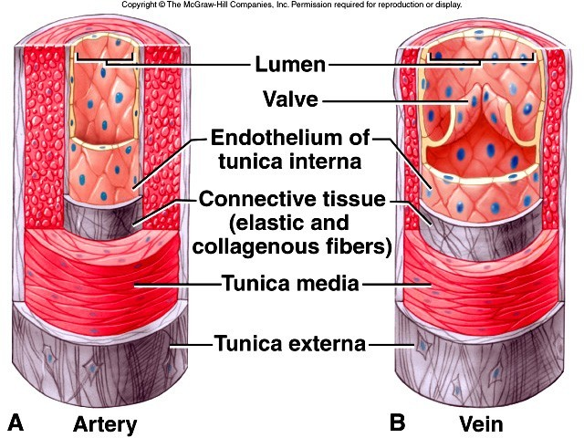
Anatomical Review

Slide 3
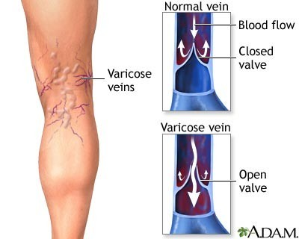
Varicose veins

Slide 4
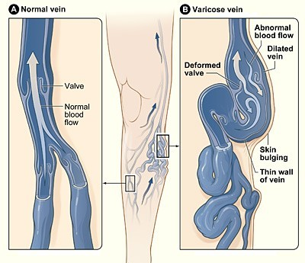
Introduction
Dilated, swelled leg veins with back flow of blood caused by incompetent valve closure, which results in venous congestion and vein enlargement
Usually saphenous branches
affects the vein and its

Slide 5
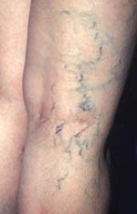
Types of varicose vein
Primary varicose veins

Slide 6
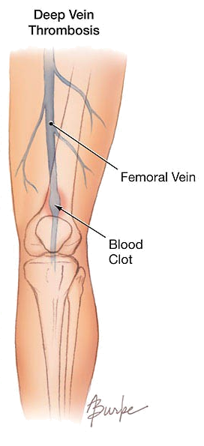
Types of varicose vein
Primary varicose veins
Secondary varicose veins

Slide 7
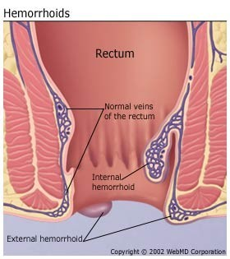
Types of varicose vein
Primary varicose veins
Secondary varicose veins:
^{ϖ} Hemorrhoids

Slide 8
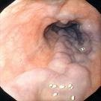
Types of varicose vein
Primary varicose veins
Secondary varicose veins:
Hemorrhoids
Esophageal varices

Slide 9

Types of varicose vein
Primary varicose veins
Secondary varicose veins:
Hemorrhoids
Esophageal varices
Varicocele

Slide 10
Risk factor
Genetics
Age
Gender
Pregnancy
Overweight and obesity
Posture

Slide 11
Causes
Congenital absent or defective venous valves.
Elevation of venous pressure
Incompetent venous valves
Chronic systemic disease
Infections and trauma

Slide 12
Pathophysiology
Any risk factor/cause
↓
↑ced venous pressure
↓
Dilation of veins
↓
Valves stretched
↓
Incompetent valve
↓
Reverse blood flow
↓
Calf muscles fail to pump blood
↓
Venous distention

Slide 13
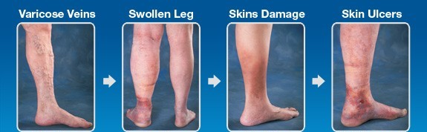
Clinical manifestations
Enlarged veins that are visible on skin
Mild swelling of ankles and feet
Painful, achy, or “heavy” legs
Throbbing or cramping in legs
Itchy legs, especially in the lower leg and ankle
Discoloration of skin surrounding the varicose veins

Slide 14
Diagnostic Evaluation
Appearance

Slide 15

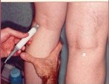
Diagnostic Evaluation
Appearance
Hand held Doppler examination

Slide 16
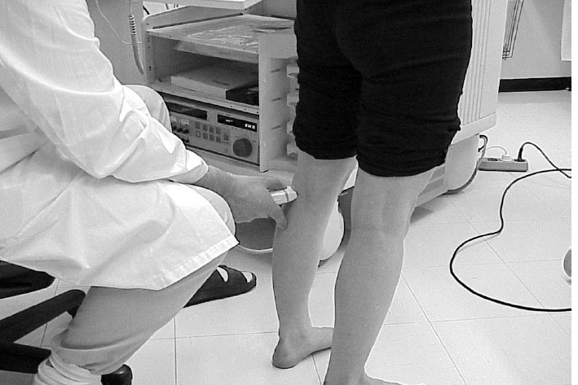
Diagnostic Evaluation
Appearance
Hand held Doppler examination
Duplex Ultrasonography

Slide 17
Diagnostic Evaluation
Appearance
Hand held Doppler examination
Duplex Ultrasonography
Trendelburg’s test

Slide 18
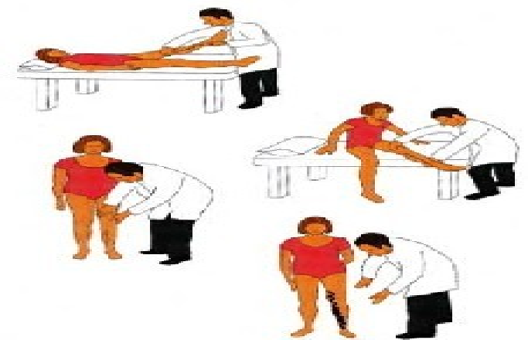
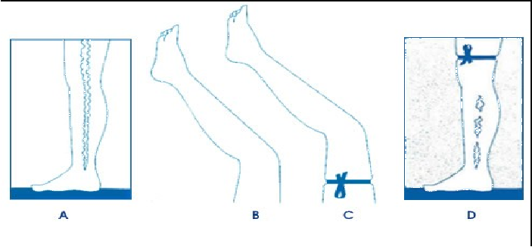

Slide 19
Management
Conservative management
  Elevation of the legs
  Avoid prolonged sitting & standing
  Compression stockings
  Exercise
  Lose weight

Slide 20
Management Cont……
Sclerotherapy
Sclerosant agent: sodium tetradecyl sulphate
dose: 0.25 - 1ml at one site and maximum can be 4 ml at 4 different sites in superficial vein.
Action: irritation to the intima of the vein wall, causes hardening of vein so that they no longer fill with blood. Blood that would normally return to the heart through these veins returns to the heart by way of other veins. The veins that received the injection will eventually shrivel and disappear. The scar tissue is absorbed by the body.

Slide 21
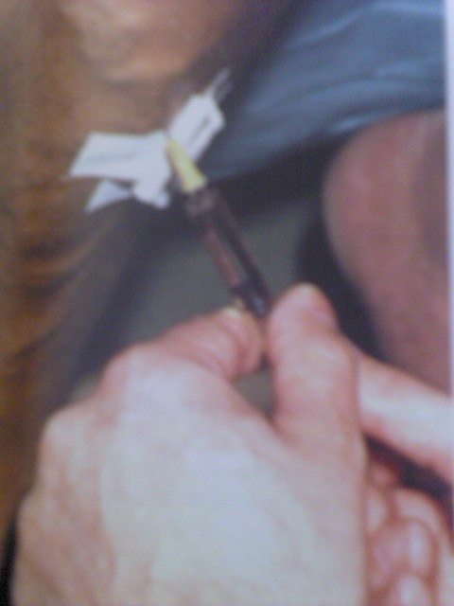
Sclerotherapy

Slide 22
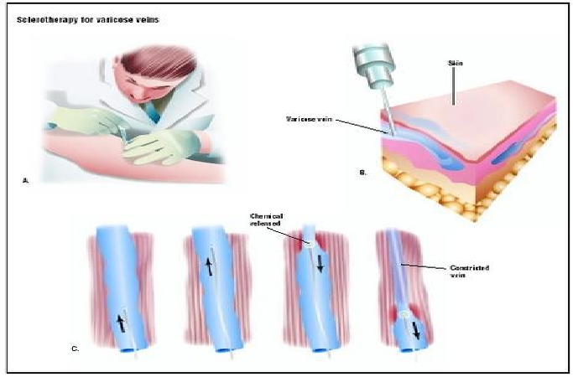

Slide 23
Management Cont……
Vein stripping and ligation: This procedure involves tying off all varicose veins associated with the leg's main superficial vein and removing it from the leg. The removal of veins from the leg will not affect the blood circulation in the leg as deeper veins will be able to take care of the increased blood circulation

Slide 24

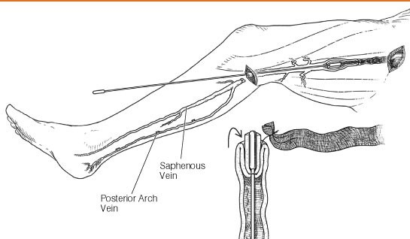
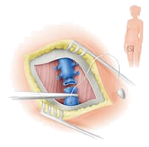


Slide 25
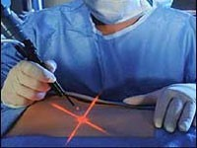
Management Cont……
Laser treatment: This procedure uses no incisions or injections. Light energy from a laser is used to make the vein fade away. Laser surgery is typically used to treat smaller varicose veins.

Slide 26
Management Cont……
Endovenous ablation therapy: A tiny incision is made in the skin & small catheter is inserted into the vein. A device at the tip of the catheter heats up inside the vein, which causes it to close off.

Slide 27
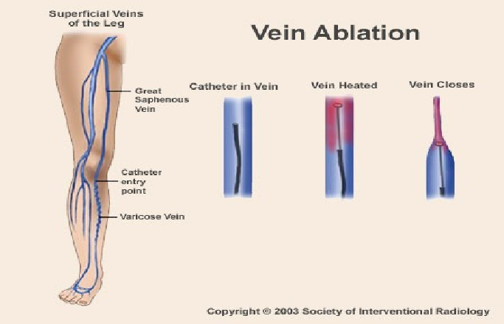


Slide 28

Nursing management
Altered tissue perfusion related to chronic changes & postoperative inflammation
Altered body comfort related to pain
Knowledge deficit related to disease process and prevention.

Slide 29
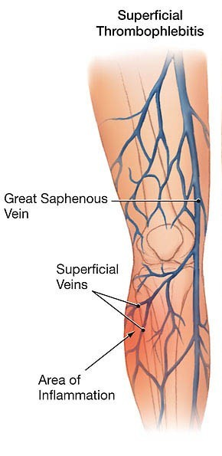
Complications
Superficial thrombophlebitis

Slide 30
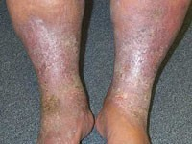
Complications
Superficial thrombophlebitis
Lipodermatosclerosis

Slide 31
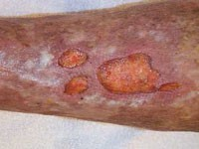
Complications
Superficial thrombophlebitis
Lipodermatosclerosis
Venous ulceration

Slide 32
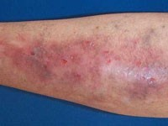
Complications
Superficial thrombophlebitis
Lipodermatosclerosis
Venous ulceration
Venous eczema

Slide 33




Slide 34
Summary
Introduction
Types of varicose veins
Risk factors
Causes
Pathophysiology
Diagnostic evaluation
Clinical management
Nursing management
Complications
Health education

Slide 35
Bibliography
Black M. Joyce “Medical-Surgical Nursing” Ed.6th; Saunders publication; 2007; (2); 1426-27.
Barley & love “Short Practices of Surgery” Ed.24th; Edward Arnold publisher; 2004; 956-63.
Christensen & Kockrow “Adult Health Nursing” Ed.4th; Mosbys; 2003; 333-34.
Nettina M.S. “Lippincott Manual of Nursing practices” Ed. 8th; Lippincott; 2006; 442 -43.
Smeltzer Suzanne “Brunner & Suddarth’s Textbook of medical surgical nursing” Ed 11th; Lippincott; 2008; 1014-16

Slide 36
